Slide 1
Module III: Memory Systems & Cache Organization
Prepared By- Ashwini Dhumal

Slide 2
Syllabus:
Memory Hierarchy: Concept and need for memory hierarchy, Levels of memory.
Memory Performance: Latency, Throughput, Bandwidth.
Memory Technologies: Overview of main memory technologies.
Cache Memory: Purpose of cache memory, Instruction and data caches, Unified cache.
Cache Mapping and Operations: Cache mapping techniques, Cache hit and miss, Write-through and write-back policies.
Cache Performance: Tag and data arrays, Types of cache misses, Multi-level caches,
Cache replacement policies (LRU).

Slide 3
Prerequisites for Memory Hierarchy and Cache Memory
Basic Computer Organization: CPU, memory, and input/output devices.
Primary and Secondary Memory: RAM, ROM, hard disk, and SSD.
Registers and CPU Operations: Purpose of registers and their role in instruction execution.
Number System
Memory Addressing: Memory locations, addresses, and addressable units.
Basic CPU Instruction Execution: Fetch, decode, execute cycle and Store.

Slide 4
Memory Hierarchy: Concept and need for memory hierarchy
What is Memory Hierarchy?
Memory hierarchy is the systematic arrangement of different types of memory in a computer system according to their speed, storage capacity, cost per bit.
A computer uses different types of memory because no single memory technology can provide all three features at the same time:
      Very high speed
      Very large storage capacity
      Very low cost
For example, CPU registers are extremely fast but can store only a small amount of data. An SSD can store a large amount of data at a lower cost per bit, but it is much slower than registers.
Therefore, computer systems combine different memory types into a hierarchy to achieve a balance between performance, capacity, and cost.

Slide 5
Need for Memory Hierarchy
Memory hierarchy is required in a computer system to achieve a balance between speed, storage capacity, and cost.
Different memory technologies have different performance characteristics, so a computer uses multiple levels of memory to improve overall efficiency.
Why do we need Memory Hierarchy?
1. To overcome the speed gap between CPU and memory
The CPU processes data very quickly, but RAM is slower than the CPU's internal registers and cache. Memory hierarchy reduces CPU waiting time by keeping frequently needed data in faster memory.
2. To improve system performance
Frequently accessed instructions and data are stored in cache memory. This allows the CPU to access them faster than if every request had to go to RAM.
3. To reduce the cost of memory
High-speed memory, such as registers and cache, is expensive per bit. Using only this type of memory would make a computer costly. Memory hierarchy combines small amounts of fast memory with larger amounts of affordable memory.

Slide 6
4. To provide large storage capacity
Registers and cache have limited capacity. RAM and secondary storage provide additional space for running programs, files, applications, and large datasets.
5. To reduce average memory access time
When requested data is found in a fast memory level, the CPU avoids accessing slower levels. This reduces the average time needed to retrieve data.
6. To support efficient program execution
Programs often reuse recently accessed data and access nearby memory locations. Cache memory exploits these patterns to make program execution more efficient.

Slide 7
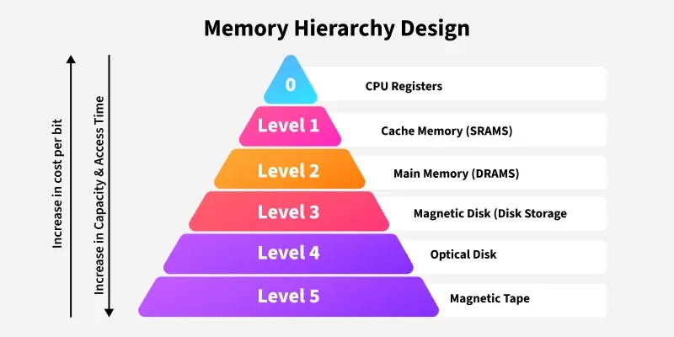
Types of Memory Hierarchy OR Levels of memory.
This Memory Hierarchy Design is divided into 2 main types:
External Memory or Secondary Memory: Comprising of Magnetic Disk, Optical Disk, and Magnetic Tape i.e. peripheral storage devices which are accessible by the processor via an I/O Module.
Internal Memory or Primary Memory: Comprising of Main Memory, Cache Memory & CPU registers. This is directly accessible by the processor.

Slide 8
Memory Hierarchy Design
1. Registers
Registers are small, high-speed memory units located in the CPU. They are used to store the most frequently used data and instructions. Registers have the fastest access time and the smallest storage capacity, typically ranging from 16 to 64 bits.
2. Cache Memory
Cache memory is a small, fast memory unit located close to the CPU. It stores frequently used data and instructions that have been recently accessed from the main memory. Cache memory is designed to minimize the time it takes to access data by providing the CPU with quick access to frequently used data.

Slide 9
3. Main Memory
Main memory, also known as RAM (Random Access Memory), is the primary memory of a computer system. It has a larger storage capacity than cache memory, but it is slower. Main memory is used to store data and instructions that are currently in use by the CPU.
Types of Main Memory
Static RAM: Static RAM stores the binary information in flip flops and information remains valid until power is supplied. Static RAM has a faster access time and is used in implementing cache memory.
Dynamic RAM: It stores the binary information as a charge on the capacitor. It requires refreshing circuitry to maintain the charge on the capacitors after a few milliseconds. It contains more memory cells per unit area as compared to SRAM.

Slide 10
4. Secondary Storage
Secondary storage, such as hard disk drives (HDD) and solid-state drives (SSD) , is a non-volatile memory unit that has a larger storage capacity than main memory. It is used to store data and instructions that are not currently in use by the CPU. Secondary storage has the slowest access time and is typically the least expensive type of memory in the memory hierarchy.
5. Magnetic Disk
Magnetic Disks are simply circular plates that are fabricated with either a metal or a plastic or a magnetized material. The Magnetic disks work at a high speed inside the computer and these are frequently used.
6. Magnetic Tape
Magnetic Tape is simply a magnetic recording device that is covered with a plastic film. Magnetic Tape is generally used for the backup of data. In the case of a magnetic tape, the access time for a computer is a little slower and therefore, it requires some amount of time for accessing the strip.

Slide 11
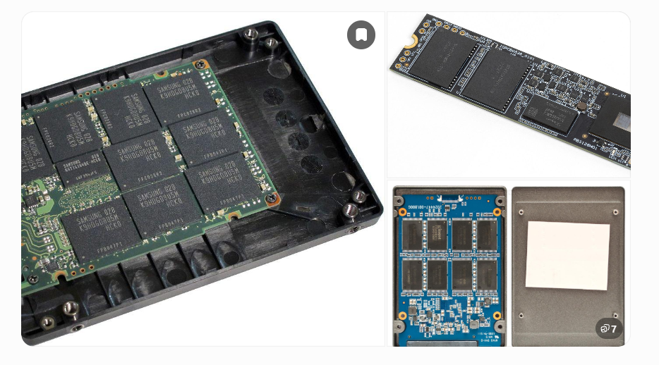
SSD (Solid-State Drive)

Slide 12
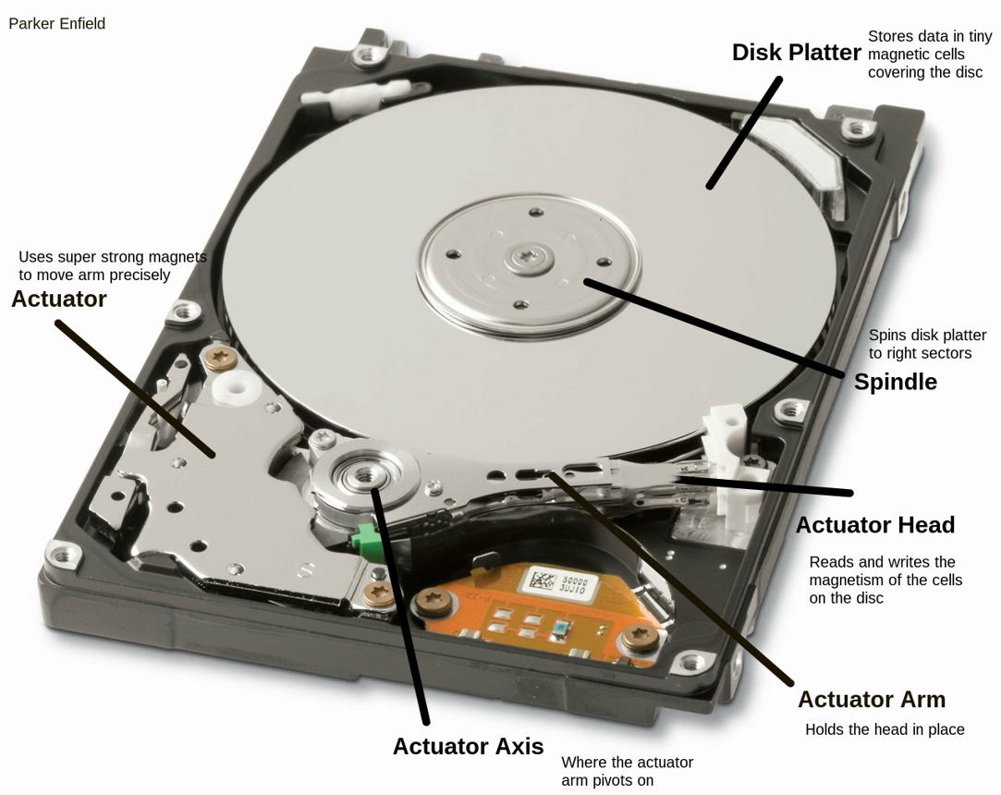
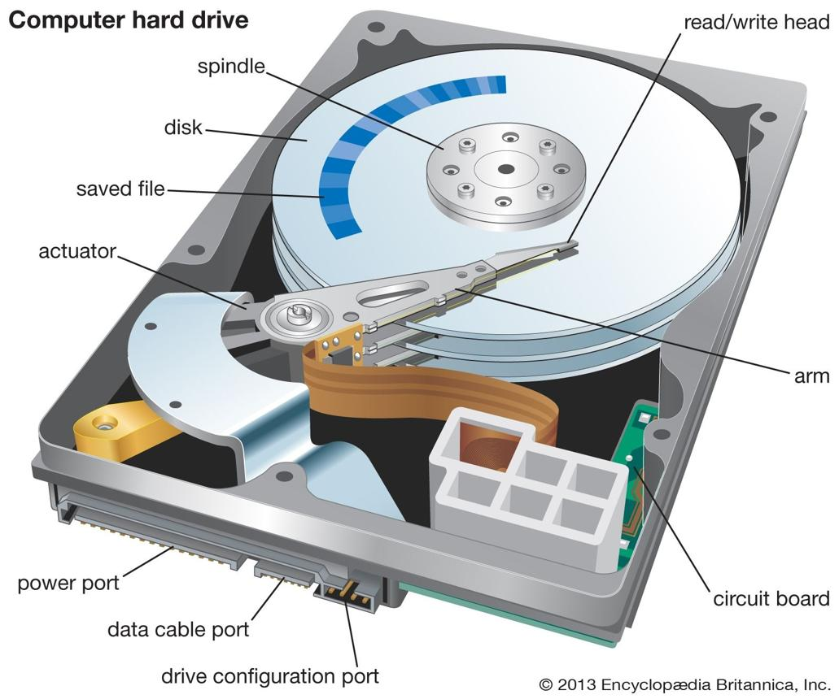
What is a Magnetic Disk?
A magnetic disk is a non-volatile secondary storage device that stores data by magnetizing tiny regions on a rotating disk coated with magnetic material.
A common example is the Hard Disk Drive (HDD) used in desktop computers, laptops, and servers.

Slide 13
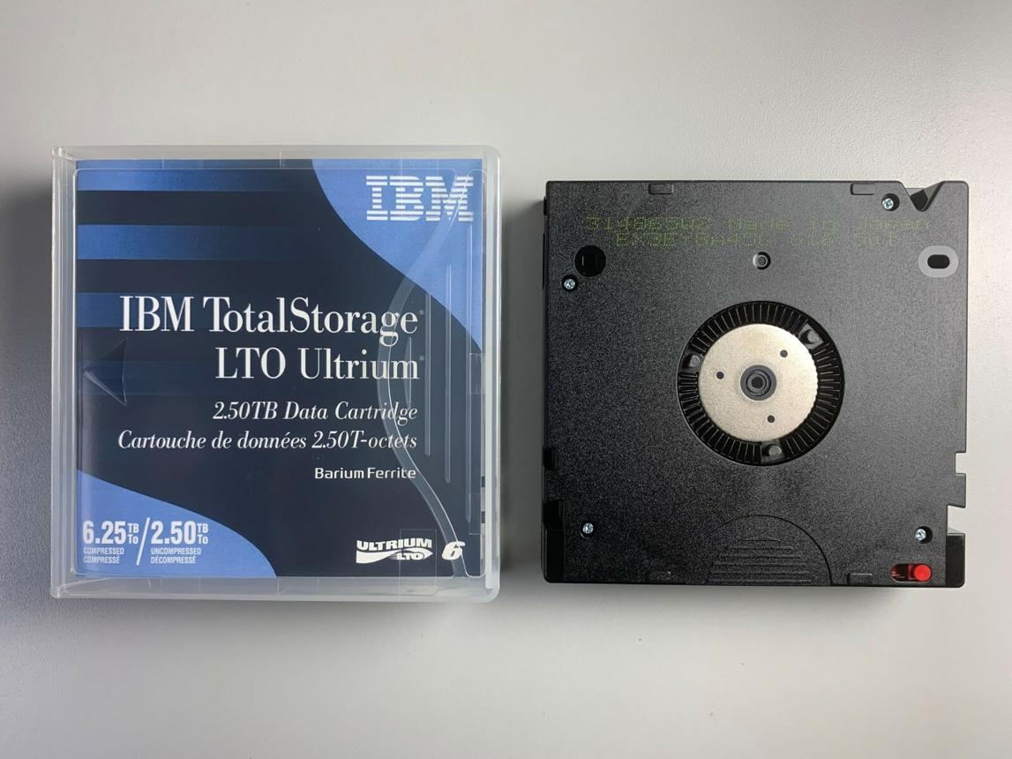
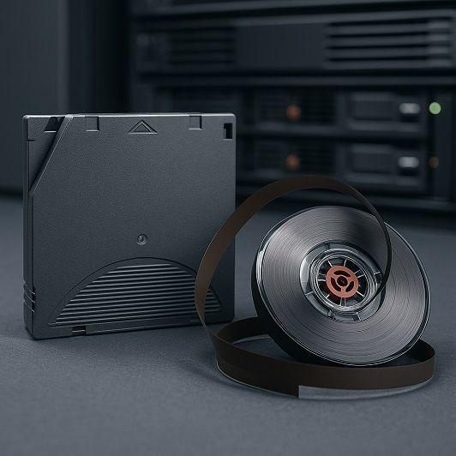
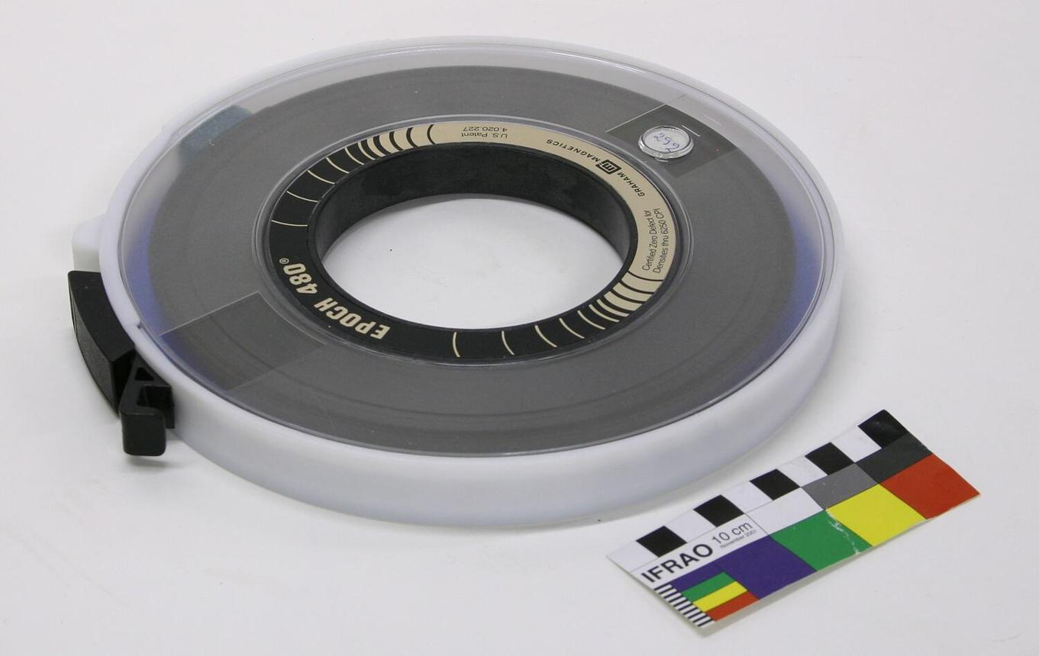
Magnetic Tape

Slide 14
Memory Performance: Latency, Throughput, Bandwidth
Memory performance describes how efficiently a computer's memory system supplies data to the CPU. It helps us understand how quickly data can be accessed and how much data can be transferred in a given time.
The three important parameters are:
Latency – How long it takes to access data.
Throughput – How much data is actually transferred per unit time.
Bandwidth – How much data can be transferred per unit time under specified conditions.

Slide 15
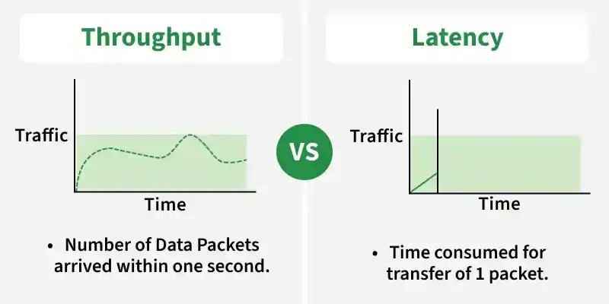
Latency and throughput are important concepts in system design that help measure how well a system performs. They are often used to evaluate speed, efficiency, and overall user experience.
Latency tells how fast a system responds to a request.
Throughput tells how much work a system can handle over time.

Slide 16
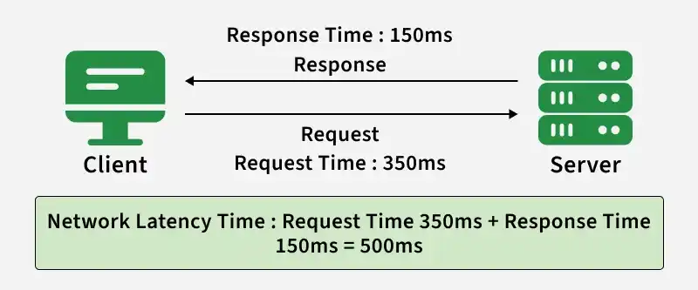
Latency
Latency is the total time taken for a request to travel from the client to the server and back with a response. It represents the delay experienced in a system and directly impacts user experience. It includes multiple types of delays that occur during communication.
Latency represents the delay between an action and its corresponding reaction.
It can be measured in various units like seconds, milliseconds, and nanoseconds depending on the system and application.
Example: When you click a website link, the time between clicking and the page loading is the latency.
Latency

Slide 17
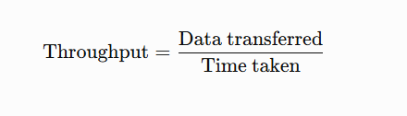

Throughput
Definition: Memory throughput is the actual amount of data successfully transferred or processed by the memory system per unit of time.
In simple words, throughput tells us how much data is actually transferred in a given time.
Example: an ice-cream factory produces 50 ice-creams in an hour so the throughput of the factory is 50 ice-creams/hour.
Formula
Example
Suppose a memory system transfers 600 MB of data in 2 seconds.
Therefore, the actual throughput is 300 MB/s.
Key point: Higher throughput generally means more data is being transferred successfully per second.

Slide 18
Memory Bandwidth
Memory bandwidth refers to the rate at which data can be transferred between memory (such as DRAM, VRAM, or high bandwidth memory (HBM)) and processing units such as CPUs, GPUs.
In simple words, bandwidth tells us how much data the memory system can transfer per second.
It is typically measured in gigabytes per second (GB/s) and represents the maximum amount of data that can be read from or written to memory within a given timeframe.
Think of it as a highway for data; the wider the highway, the more data can travel at once.

Slide 19

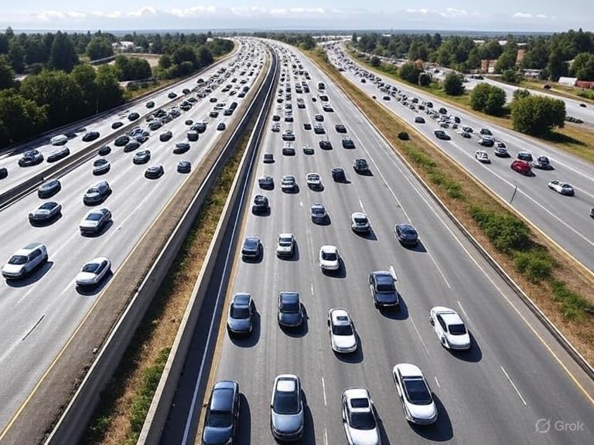
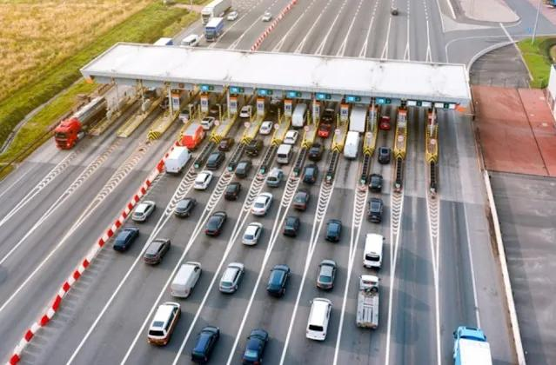
Real-Life Example: Highway Analogy
Latency = Waiting time
How long does one car wait before passing through the toll booth?
Bandwidth = Highway capacity
How many cars per second could pass through under ideal conditions?
Throughput = Actual traffic flow
How many cars per second actually pass through?

Slide 20
Difference Between Latency, Throughput and Bandwidth
Parameter | Latency | Throughput | Bandwidth
Meaning | Time required to access data | Actual data transferred per unit time | Data-transfer capacity per unit time
Measures | Delay | Actual performance | Transfer capability
Unit | ns, clock cycles | MB/s, GB/s | MB/s, GB/s
Desired value | Low | High | High

Slide 21
Memory Technologies: Overview of Main Memory Technologies
1. Introduction
Memory technology refers to the methods and electronic devices used to store data, instructions, and information in a computer system. Memory is essential for processing data and running programs.
Computer memory is broadly classified into:
Primary memory (main memory): Memory directly accessible by the CPU, such as RAM and ROM.
Secondary memory: Storage devices such as SSDs, HDDs, and optical disks, used for long-term data storage.

Slide 22
2. Main Memory Technologies
The main memory technologies are SRAM, DRAM, ROM, PROM, EPROM, EEPROM, and Flash memory.
1. SRAM (Static RAM)
SRAM stores each bit using a circuit called a flip-flop.
Very fast access speed.
Does not require periodic refreshing.
Volatile: data is lost when power is turned off.
Expensive and has lower storage density than DRAM.
Uses: CPU cache memory.

Slide 23
2. DRAM (Dynamic RAM)
DRAM stores each bit using a transistor and a capacitor.
Requires periodic refreshing to retain data.
Slower than SRAM.
Cheaper and offers higher storage density.
Volatile memory.
Uses: Main memory in computers and laptops.
3. ROM (Read-Only Memory)
ROM stores information that is retained even when power is turned off.
Non-volatile memory.
Traditionally designed mainly for reading.
Stores permanent instructions and firmware.
Uses: Embedded systems and firmware storage.

Slide 24
4. PROM (Programmable ROM)
PROM is manufactured blank and can be programmed once.
Non-volatile.
Data cannot normally be erased and rewritten.
Uses: Permanent program and configuration storage.
5. EPROM (Erasable Programmable ROM)
EPROM can be erased using ultraviolet light and programmed again.
Non-volatile.
Can be reused after erasing.
Erasure usually clears the entire chip.
Uses: Older firmware development and testing.

Slide 25
6. EEPROM (Electrically Erasable Programmable ROM)
EEPROM can be erased and reprogrammed electrically.
Non-volatile.
Can update data without removing the chip.
Usually supports rewriting smaller portions of data.
Uses: Device settings, calibration data, and configuration storage.
7. Flash Memory
Flash memory is a type of electrically erasable non-volatile memory.
Retains data without power.
Erases data in blocks.
Compact, durable, and energy-efficient.
Uses: SSDs, USB drives, memory cards, and embedded devices.

Slide 26
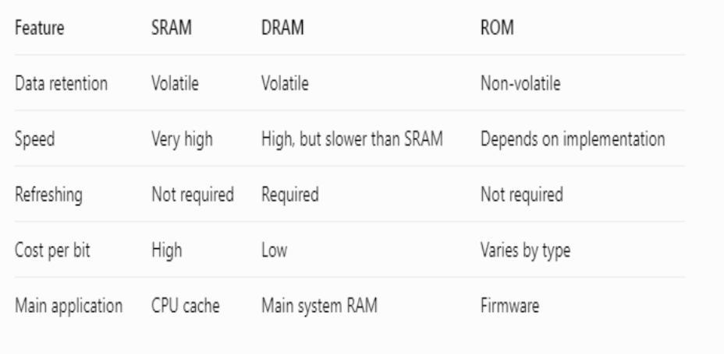
Comparison of Memory Technologies

Slide 27
Advantages of Main Memory Technologies
SRAM: Extremely fast; suitable for high-speed processing.
DRAM: High capacity at a relatively low cost; suitable for system memory.
ROM: Stores essential instructions even when power is off.
PROM and EPROM: Useful for programmable firmware.
EEPROM: Allows electrical updating of stored information.
Flash memory: Provides compact, persistent storage with no moving parts.

Slide 28
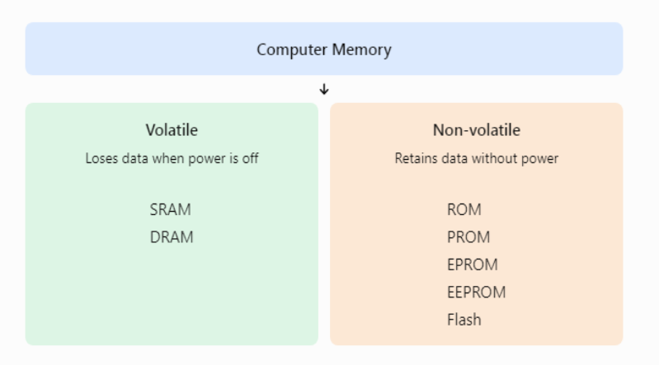
Classification of Memory

Slide 29
Memory technologies play an important role in computer performance and data storage. SRAM is mainly used for cache, DRAM for main memory, and ROM-family technologies for non-volatile storage. Flash memory is widely used in modern storage devices. The choice of technology depends on speed, cost, capacity, power consumption, and whether data must be retained without power.

Slide 30
Introduction to Cache Memory
Cache memory is a small, high-speed memory located inside or close to the CPU. It stores frequently used instructions and data so that the processor can access them faster than from main memory (RAM).
The CPU operates much faster than RAM. Cache memory helps reduce this speed difference and improves overall system performance.

Slide 31
Cache Memory: Purpose of cache memory
Key Purposes and Functions
Accelerate Data Access: Cache memory is much faster than standard RAM, allowing the CPU to read and write information in nanoseconds instead of waiting longer cycles.
Reduce CPU Wait Time (Latency): By holding copies of data that the processor is likely to request next—relying on a concept called locality of reference—it prevents the CPU from sitting idle.
Bridge Speed Gaps: It acts as a high-speed buffer between the ultra-fast CPU and the slower main memory or storage drives.
Handle Multiple Tiers: Modern systems use a hierarchy of caches—such as L1, L2, and L3 caches—to balance storage capacity and speed, keeping the most critical instructions right inside or adjacent to the processor core

Slide 32
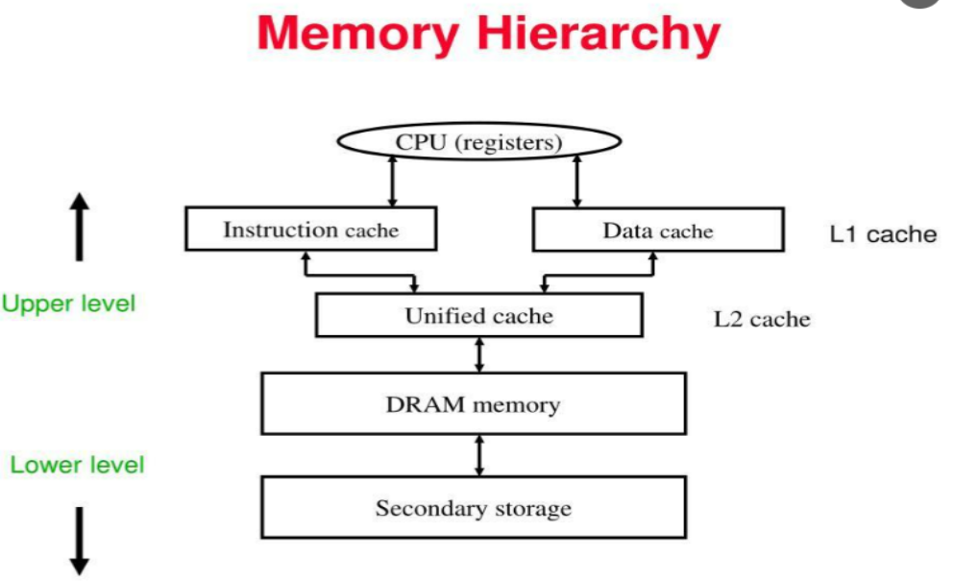

Slide 33
Instruction and Data Caches (Split Caches)
Instruction Cache (I-Cache): Dedicated solely to storing executable machine instructions that the CPU needs to run next.
Data Cache (D-Cache): Dedicated to storing variables, operands, and temporary calculation results loaded or stored by program execution.
Why Split Them: Separating instructions and data prevents structural hazards (contention), allowing the CPU to fetch an instruction and access data simultaneously in the same clock cycle. This is typical at the Level 1 (L1) cache stage.

Slide 34
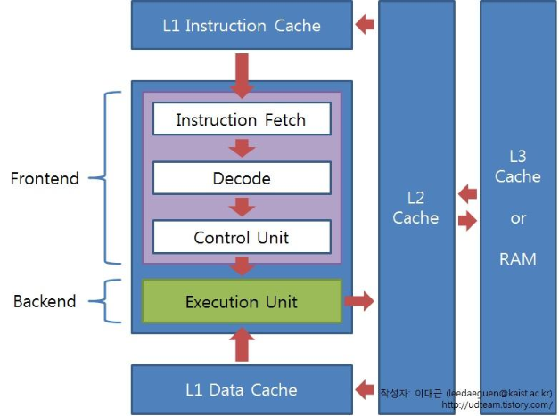
Instruction Cache
An instruction cache (I-cache) stores copies of program instructions that the CPU is likely to execute soon.
Its main purpose is to provide instructions quickly to the processor for decoding and execution.

Slide 35
Working of Instruction Cache
The CPU requests the next instruction.
The instruction cache checks whether it contains that instruction.
If a cache hit occurs, the instruction is supplied quickly.
If a cache miss occurs, the instruction is fetched from a lower memory level.
The instruction may then be stored in the cache for future use.

Slide 36
Advantages
Faster instruction fetching.
Improved instruction pipeline performance.
Reduced demand for instruction reads from RAM.
Better execution efficiency for frequently used code.

Slide 37
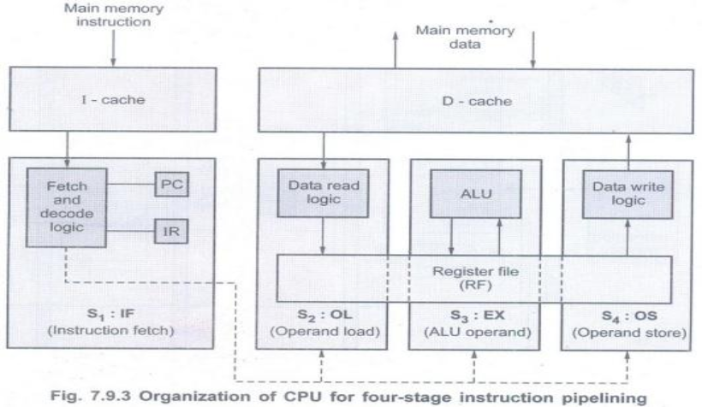
Data Cache
A data cache (D-cache) stores copies of data values that the CPU reads or writes during program execution.
It helps the processor access variables, arrays, and other frequently used data quickly.

Slide 38
Working of Data Cache
The CPU requests a data value from memory.
The data cache checks whether the value is available.
If found, the value is supplied to the CPU.
If absent, the data is fetched from a lower memory level.
Depending on the cache write policy, updates may be written to the cache and/or main memory.
Example: Consider a program that repeatedly calculates the sum of elements in an array. The data cache can retain recently accessed array elements, helping subsequent accesses complete faster.

Slide 39
Advantages
Faster access to frequently used data.
Reduced average memory access time.
Improved performance of loops and calculations.
Efficient handling of repeated data accesses.

Slide 40
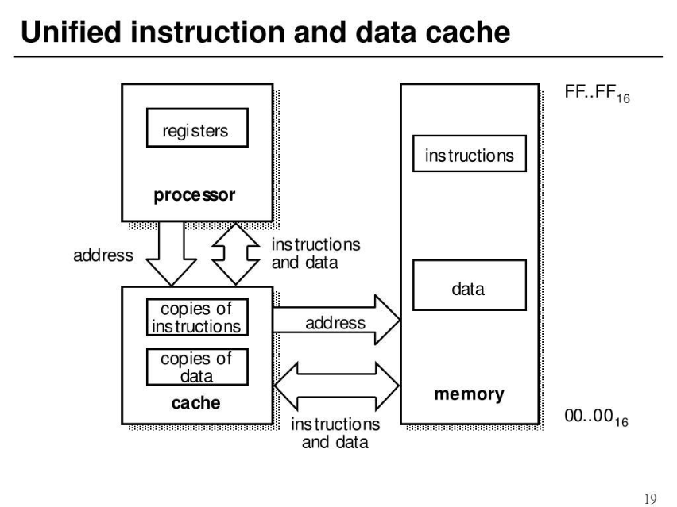
Unified Cache
A unified cache stores both program instructions and data in the same cache structure.
Unlike separate instruction and data caches, a unified cache does not dedicate its entire capacity exclusively to instructions or exclusively to data.

Slide 41
Working of Unified Cache
The CPU requests instructions or data.
Both types of requests use the same cache.
The cache checks for the requested information.
On a hit, it supplies the information to the CPU.
On a miss, it fetches the information from a lower memory level.

Slide 42
Advantages
Cache capacity can be shared flexibly between instructions and data.
May reduce wasted space when one type of information needs more capacity.
Can simplify cache organization.
Disadvantages
Instruction and data requests may compete for cache capacity.
Accesses may contend for shared cache resources.
Performance depends on workload and cache design.

Slide 43
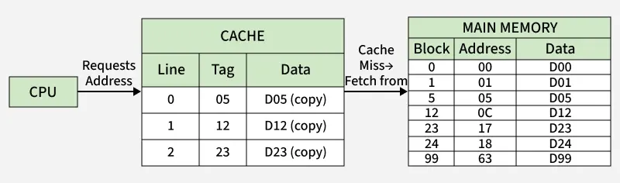
Cache Mapping and Operations: Cache mapping techniques
In modern computer systems, the speed difference between the processor and main memory (RAM) can significantly affect system performance. To bridge this gap, computers use a small, high-speed memory known as cache memory. But since cache is limited in size, the system needs a smart way to decide where to place data from main memory — and that’s where cache mapping comes in.
Cache mapping is a technique used to determine where a particular block of main memory will be stored in the cache.
It defines how and where that new data block from main memory will be placed inside the cache.
Cache-RAM Mapping

Slide 44
Key Terminologies in Cache Mapping
Before diving into mapping techniques, let’s understand some important terms:
Main Memory Blocks: The main memory is divided into equal-sized sections called blocks.
Cache Lines (or Cache Blocks): The cache memory is also divided into equal partitions called cache lines.
Block Size: The number of bytes or words stored in one block or line.
Tag Bits: A small portion of the address used to identify which block of main memory is stored in a particular cache line.
Number of Cache Lines: Determined by the ratio of Cache Size ÷ Block Size.

Slide 45
Types of Cache Mapping
There are three main cache mapping techniques used in computer systems:
Direct mapping
Fully associative mapping
Set-associative mapping

Slide 46
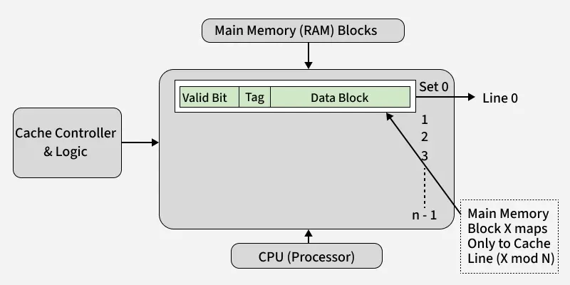
1. Direct Mapping
In Direct mapping, each block of main memory maps to exactly one specific cache line.
The formula for finding the cache line is:
Cache Line Number=(Block Number) MOD (Number of Cache Lines)
Example: Suppose the cache has 8 lines and the main memory block number is 19.
19 mod 8=3
Therefore, block 19 is mapped to cache line 3.
Direct Mapping
Notes:
byte offset tells us how far a particular byte is from the starting point.
For example, if a memory block starts at address 1000, then:
Byte offset 0 refers to address 1000.
Byte offset 1 refers to address 1001.
Byte offset 2 refers to address 1002.
Byte offset 3 refers to address 1003.

Slide 47
Each memory block has a fixed location in the cache.
It is simple and fast.
Two frequently used blocks may compete for the same cache line.
Example: Suppose the cache has 4 lines.
Main memory block | Cache line
Block 0 | Line 0
Block 1 | Line 1
Block 2 | Line 2
Block 3 | Line 3
Block 4 | Line 0
Block 5 | Line 1
Here, Block 0 and Block 4 both map to Cache Line 0.

Slide 48
Advantages
Simple to implement.
Fast and inexpensive.
Requires little hardware.
Disadvantages
Different blocks may compete for the same cache line.
Can cause frequent conflict misses.

Slide 49
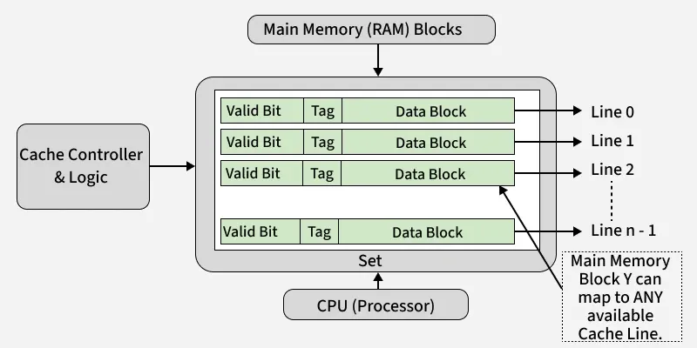
2. Fully Associative Mapping
In fully associative mapping, a memory block can be stored in any line of the cache.
Unlike direct mapping, there is no fixed cache line assigned to each memory block.
In fully associative mapping, a memory block can be stored in any line of the cache.
There is no line number here because placement is flexible — any block can go into any cache line.
Example: If the cache has 4 lines, Block 0 can be stored in Line 0, Line 1, Line 2, or Line 3.
Fully Associative Mapping

Slide 50
Advantages
Flexible placement.
Fewer conflict misses than direct mapping.
Disadvantages
Requires more complex and costly hardware.
Searching for a matching tag can require parallel comparisons across many lines.

Slide 51
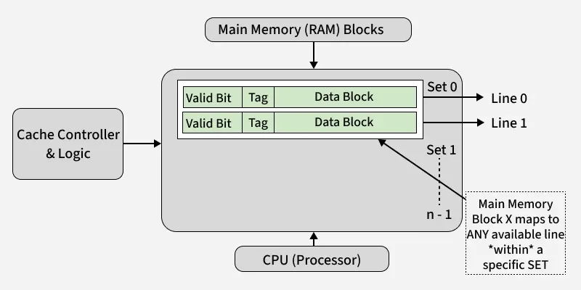
3. Set-Associative Mapping
Set-associative mapping combines the benefits of both direct and fully associative mapping.
The cache is divided into a number of sets, each containing a few lines (e.g., 2-way, 4-way set associative).
A memory block maps to exactly one set, but can be placed in any line within that set.
The mapping formula is:
Set Number = (Block Number) MOD (Number of Sets)
2-way Set Associative Mapping

Slide 52
Example: Suppose a cache has 4 lines divided into 2 sets, with 2 lines per set.
Set | Cache lines
Set 0 | Line 0, Line 1
Set 1 | Line 2, Line 3
A memory block mapped to Set 0 can occupy either Line 0 or Line 1.

Slide 53
Advantages
Fewer conflict misses than direct mapping.
Less expensive than fully associative mapping.
Disadvantages
More complex than direct mapping.
Requires a replacement policy when all lines in a set are occupied.

Slide 54
Need for Cache Mapping
Cache mapping is essential for two main reasons:
Locate Data Efficiently: It helps the processor quickly determine whether the required data is in the cache (cache hit) or must be fetched from main memory (cache miss).
Manage Data Placement: When a cache miss occurs, mapping tells the system where in the cache to place the new memory block.

Slide 55
Real-Life Analogy
Imagine a parking lot:
Direct Mapping: Each car has a fixed parking spot number.
Fully Associative: Any car can park in any spot.
Set-Associative: Cars are assigned to a specific section, but can park in any space within that section.
This analogy helps visualize how memory blocks find their “parking spots” in the cache.

Slide 56
Feature | Direct Mapping | Fully Associative | Set-Associative
Placement | One fixed line | Any line | Any way within one set
Hardware complexity | Low | High | Moderate
Search method | One line selected | Compare tags across all lines | Compare tags within selected set
Conflict misses | More likely | Least restrictive placement | Reduced in many cases
Replacement policy | Not needed to choose a line | Required when full | Required when selected set is full
Cost | Low | High | Moderate
Main benefit | Simplicity | Maximum flexibility | Balance of speed and flexibility

Slide 57
Cache Hit and Cache Miss
Cache Hit
A cache hit occurs when the requested data is already present in the cache.
Example: The CPU requests data stored in cache line 4, and the required data is found there.
Access is fast.
Main memory access is avoided for that read.
Cache Miss
A cache miss occurs when the requested data is not present in the cache.
The system must fetch the required block from a lower level of the memory hierarchy, such as RAM, and usually place it in the cache.
Access takes longer.
The CPU may need to wait for the data.

Slide 58
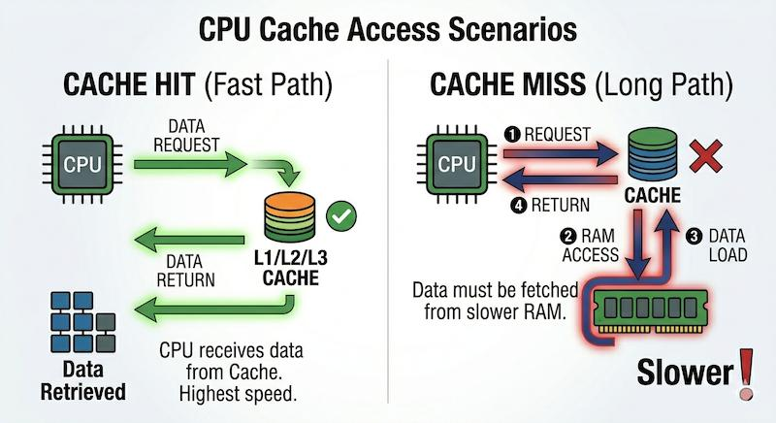

Slide 59
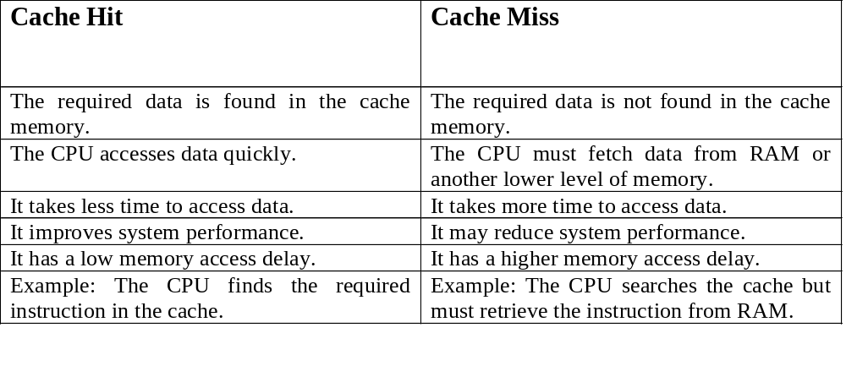

Slide 60
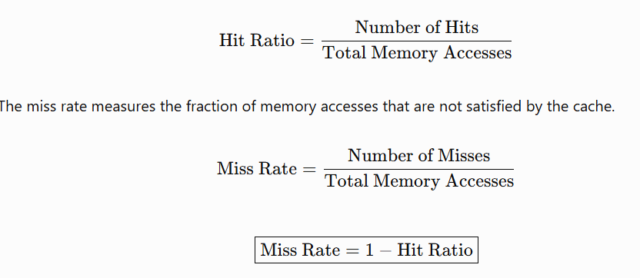
Hit ratio and miss rate
The hit ratio measures the fraction of memory accesses that are satisfied by the cache.
Module III: Memory Systems & Cache Organization
2

Slide 61
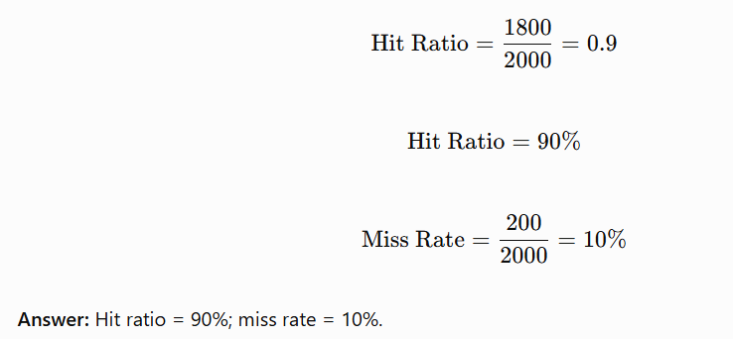
Ex: Suppose a processor makes 2,000 memory accesses. Of these, 1,800 are cache hits and 200 are cache misses.
Module III: Memory Systems & Cache Organization
2

Slide 62
Write-through policy
A Write-Through Policy is a cache memory writing technique in which every time the CPU updates data in the cache, the same data is immediately written to the main memory (RAM).
In simple words, whenever the CPU changes data, the change is saved in both the cache and RAM simultaneously.
Working
  The CPU modifies a value.
  The cache updates the corresponding cache line.
  The updated value is propagated to the next memory level.
  The system maintains consistency between the cache and the memory level being updated, subject to the cache hierarchy.
Module III: Memory Systems & Cache Organization
2

Slide 63
Example
Suppose a variable A initially contains the value 10 in both cache and RAM.
The CPU changes A from 10 to 20.
Step | Cache Memory | Main Memory (RAM)
Initial value | 10 | 10
CPU writes 20 | 20 | 20
Result: Both cache and RAM are updated with the new value, 20
Advantages | Disadvantages
Cache and RAM remain consistent for the updated data. | Every write also requires a memory write.
Data in RAM is kept up to date. | Write operations can be slower because RAM must be updated.
Simple to implement and manage. | It increases memory traffic and power consumption.

Slide 64
Write-back policy
A Write-Back Policy is a cache memory writing technique in which the CPU updates only the cache memory initially. The updated data is written to main memory (RAM) later, when the modified cache block is replaced or explicitly flushed.
In simple words, the CPU changes the data in the cache first, and RAM is updated later. This reduces the number of writes to main memory.
A cache line that has been modified but not yet written back is marked using a dirty bit.
Working
The CPU modifies data in the cache.
The cache line is marked dirty.
The next memory level may continue to contain the older value.
When the dirty line is evicted or flushed, the modified data is written back.
The dirty bit is cleared after the write-back completes successfully.
Module III: Memory Systems & Cache Organization
2

Slide 65
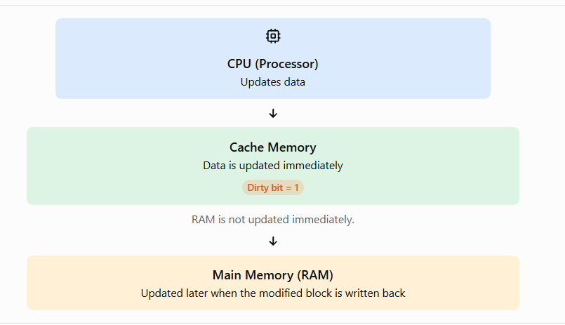
Write-Back Policy
Dirty bit: A status bit that indicates whether a cache block has been modified and differs from the corresponding data in RAM.

Slide 66
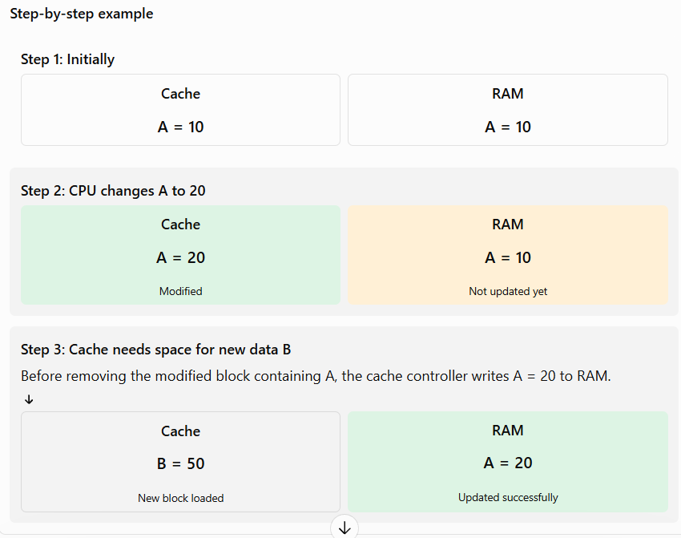
This process is called replacing a cache block. The modified data is written back to RAM before the old block is discarded.

Slide 67
Example
Suppose variable A initially contains 10 in both cache and RAM. The CPU changes its value to 20.
Step | Cache Memory | Main Memory (RAM)
Initial value | 10 | 10
CPU writes 20 | 20 | 10
Modified block is written back | 20 | 20
Result: The cache contains 20 immediately, while RAM still contains 10 until the modified block is written back.
Advantages and Disadvantages
Advantages | Disadvantages
Faster write operations in many cases. | RAM may contain outdated data temporarily.
Reduces memory traffic. | Requires a dirty bit to track modifications.
Can reduce power consumption. | Modified data must be written back before a dirty block is discarded.

Slide 68
Advantages
Reduces repeated writes to lower memory levels.
Reduces memory-bus traffic for repeated updates to the same cache line.
Can improve performance for write-intensive workloads.
Often uses memory bandwidth more efficiently.
Disadvantages
Requires dirty-bit tracking.
Evicting a dirty line requires a write-back operation.
Cache-coherence and consistency mechanisms become more involved.
A dirty cache line must be preserved or written back correctly during eviction and system transitions
Module III: Memory Systems & Cache Organization
2

Slide 69
Feature | Write-through | Write-back
Cache update | Immediate | Immediate
Next memory-level update | Propagated on each write under the basic model | Usually delayed until eviction or flush
Dirty bit | Generally not needed for tracking delayed writes | Needed to identify modified lines
Write traffic | Usually higher | Usually lower
Write performance | Can be slower without buffering | Often faster for repeated writes
Complexity | Simpler dirty-data handling | More complex management
Main advantage | Prompt propagation of writes | Reduced lower-level write traffic
Main disadvantage | More write traffic | Dirty data must be tracked and preserved
Module III: Memory Systems & Cache Organization
2

Slide 70
Cache Performance
A cache memory is built using two main component arrays: the tag array and the data array.
Tag array
The tag array stores the identifying information for the memory block present in each cache line.
It commonly contains:
Tag bits: Identify which main-memory block is stored.
Valid bit: Indicates whether the cache line contains valid data.
Dirty bit: Indicates whether the cache line has been modified, in a write-back cache.
Replacement information: May be maintained to help select a line for replacement.
Data array
The data array stores the actual instructions or data fetched from main memory. Each cache line contains a block of data.
Module III: Memory Systems & Cache Organization
2

Slide 71
Tag Array
The tag array stores the tag bits associated with each cache line.
It helps identify which block of main memory is stored in a particular cache line.
It also stores status information, such as a valid bit and sometimes a dirty bit.
The CPU compares the requested address tag with the stored tag to determine a cache hit or miss.
2. Data Array
The data array stores the actual instructions or data copied from main memory.
Each cache line contains a block of data.
When a cache hit occurs, the required data is read from the data array.
When a cache miss occurs, the required block is generally fetched from a lower level of memory and placed in the cache.
Module III: Memory Systems & Cache Organization
2

Slide 72
Tag Array | Data Array
Stores tag bits and associated status bits. | Stores actual data or instructions.
Identifies the memory block in a cache line. | Holds the contents of the memory block.
Used to check cache hits and misses. | Supplies the requested data on a hit.
Requires relatively little storage. | Usually requires much more storage.
Module III: Memory Systems & Cache Organization
2

Slide 73
Types of Cache Misses
1. Compulsory Miss (Cold-start miss)
Occurs when a block is accessed for the first time and has never been loaded into the cache.
Example: The CPU accesses a new memory location for the first time.
Solution: Prefetching may reduce the delay in some cases.
2. Capacity Miss
Occurs when the cache is too small to hold all the blocks needed by the program.
Example: A program repeatedly accesses a working set larger than the cache capacity.
Solution: Increase cache capacity or improve data locality.
3. Conflict Miss
Occurs when multiple memory blocks compete for the same cache line or set, even though other cache locations may be available.
Example: Two frequently used blocks map to the same line in a direct-mapped cache.
Solution: Increase associativity or use a different cache organization.
Module III: Memory Systems & Cache Organization
2

Slide 74
Multi-Level Caches
Modern processors use multiple cache levels to balance speed, capacity, and cost.
Levels of cache
L1 cache: Closest to the CPU core, very fast, and usually small. It is often divided into instruction cache (L1I) and data cache (L1D).
L2 cache: Larger than L1 but slower. It may be private to a core.
L3 cache: Generally larger and slower than L2 and often shared among multiple cores.
Main memory: Stores much more data but has a higher access latency than cache.
Module III: Memory Systems & Cache Organization
2

Slide 75
How multi-level caching works
The CPU first checks L1.
If L1 misses, it checks L2.
If L2 misses, it checks L3, if present.
If all cache levels miss, data is fetched from RAM and supplied to the processor.
Advantages
Reduces average memory access time.
Bridges the speed gap between the CPU and RAM.
Provides a balance between performance, capacity, and hardware cost.
Module III: Memory Systems & Cache Organization
2

Slide 76
Cache Replacement Policies — LRU
A replacement policy determines which cache block should be removed when a new block must be loaded into a full cache set.
Common policies include:
LRU (Least Recently Used)
FIFO (First In, First Out)
Random replacement
LFU (Least Frequently Used)
LRU — Least Recently Used
LRU replaces the block that has not been accessed for the longest time. It is based on the principle of temporal locality: recently accessed data is likely to be accessed again soon.
How LRU Works
The CPU requests data from the cache.
If the data is present, it is a cache hit, and the block is marked as recently used.
If the data is absent, it is a cache miss.
If the cache is full, LRU replaces the block that was used least recently.
The new data block is loaded into the cache.
Module III: Memory Systems & Cache Organization
2

Slide 77
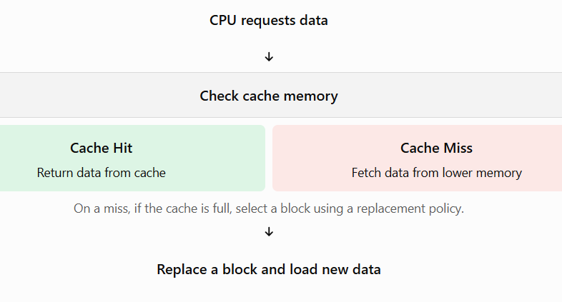
Why Are Cache Replacement Policies Needed?
Cache memory has limited storage capacity.
New data may need to be loaded when the cache is already full.
The system must decide which existing block to remove.
A good replacement policy helps reduce cache misses and improve performance.

Slide 78
Example
Assume the cache can store 3 blocks: A, B, and C.
Step | Operation | Cache Contents
1 | Load A, B, C | A, B, C
2 | Access A | A, B, C
3 | Access B | A, B, C
4 | Access A again | A, B, C
5 | Load new block D | A, B, D
Explanation: Before D arrives, C is the least recently used block. Therefore, C is replaced by D.

Slide 79
Advantages of LRU
Uses recent access history to make replacement decisions.
Often performs well when programs exhibit temporal locality.
Is deterministic for a given access sequence and initial cache state.
Disadvantages of LRU
Tracking access order requires extra hardware or bookkeeping.
Exact LRU becomes expensive for highly associative caches.
It may perform poorly for some access patterns, such as repeatedly scanning a large sequence of blocks.
Module III: Memory Systems & Cache Organization
2

Slide 80
Subject: Computer Organization & Architecture
Assignment No – III
Explain Memory Hierarchy in details
Define Latency, Throughput and Bandwidth with respect to the memory performance
Briefly explain SRAM and DRAM
Define is Cache memory and explain need of Cache memory?
Explain Cache mapping techniques
Difference between Write-through and write-back policies
Define tag array and data array with major differences
Define Cache Replacement Policies and explain LRU

